Slide 1
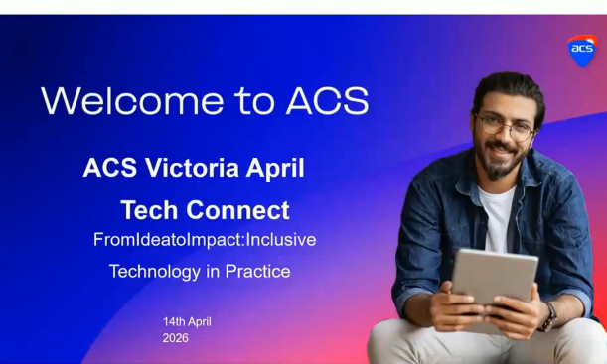
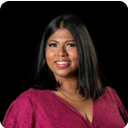
STOP PRESS!
A SPECIAL SHOWING OF
Dr. Ruwangi Fernado’s ACS Forum From Idea To Impact- Inclusive Technology in Practice (14/3/2025)
Chaired by Dr. Ruwangi Fernando
Date TBA Time TBA Location

